Slide 1

A PLAIN-LANGUAGE GUIDE
Intelligent agents turn goals into action
How they perceive, reason, act, and learn.
Notes:
This guide explains intelligent agents in plain language. The central idea is simple: an agent does not stop at an answer. It uses context, chooses a next step, acts through tools, and learns from what happens.

Slide 2

THE SHIFT
Agents do more than answer questions
Chatbots respond. Automation repeats fixed rules. Agents pursue an outcome across several steps.
Capability | Chatbot | Automation | Intelligent agent
Responds to a prompt | Yes | Sometimes | Yes
Plans multiple steps | No | Fixed rules | Yes
Uses tools | Limited | Predefined | Dynamic
Adapts to changing context | Limited | No | Yes
What makes an agent different
Notes:
A chatbot gives you a response. Traditional automation follows a fixed path. An intelligent agent can decide what needs to happen next, use the right tool, and adjust when the situation changes.

Slide 3
THE LOOP
Every agent follows a simple loop
The loop repeats until the goal is complete or a person takes over.
01
02
03
04
Perceive
Reason
Act
Learn
Goal, data, context
Options and constraints
Tools and APIs
Feedback and outcome
Working picture
Next step
Real-world result
Updated context
The agent loop · Perceive → Reason → Act → Learn → continue
Notes:
First, the agent builds a working picture from the goal, data, and context. Then it reasons about the next best step, acts through tools or APIs, and uses the result to update its context. That updated context informs the next turn of the loop.

Slide 4
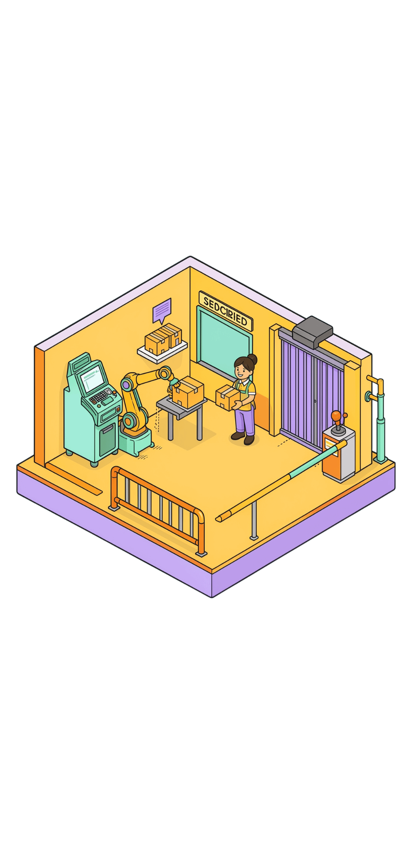




GROUNDING
Good agents stay grounded in the real world
Tools
Guardrails
Search, databases, code, and business systems.
Permissions, approvals, and safe operating limits.
Memory
Human oversight
Context, history, and prior interactions.
People review high-stakes decisions and exceptions.
Notes:
Grounding is what connects an agent to reality. Tools let it retrieve and change information. Guardrails define what it may do. Memory keeps the thread intact. Human oversight remains essential when the consequences are high.

Slide 5




A PRACTICAL START
Start with one useful workflow
Earn more autonomy by proving one outcome first.
Choose
Limit
Choose a repetitive task with a clear outcome.
Give the agent access to only the tools it needs.
Measure
Expand
Measure quality, speed, and human trust.
Expand autonomy only when the results are reliable.
One reliable loop is the foundation for the next one.
Notes:
Start small. Pick a repetitive task where success is easy to recognize. Limit the agent's access, measure both performance and trust, and expand only when the results are reliable. The same loop that powers the agent should guide how autonomy grows.

